Slide 1
SWC for R July 2017

Slide 2
Data Types
Data types | Examples
1. Logical | TRUE/FALSE, 0/1
2. Integer | 1L, 2L, 3L, 4L,…
3. Double | 1.3, 2.4, 5.6,…
4. Complex | 1+2i (imaginary numbers)
5. Character | “string”, “hello”

Slide 3
Data Structures
Dimensions | Homogeneous (single data type only) | Heterogeneous
1-D | 1. Vector (all data types) 2. Factor (integer or char) | 4. List (all data types)
2-D | 3. Matrix (all data types) | 5. Data frame (cols single data types = vector; rows multi data types = list)
Functions to explore your data:
Function | What it is trying to find out about the variable | Example output
str(variable) | Structure; almost everything about the variable – always use this | 'data.frame': 1704 obs. of 6 variables: $ country : Factor w/ 142 levels "Afghanistan",..: 1 1 1 1 1 1 1 1 1 1 …
typeof(variable) | data type | logical/integer/double...
class(variable) | data structure | data frame/list/factor…

Slide 4
Motivation for understanding R data types and structures
In order to interact with R, we need to know the language it uses to interpret its data (‘data’ language) 1) words → syntax and data type 2) how to string words into sentences → data structures 3) the different “sentences” are built with different “grammar” from data types → single data type only vs multiple data types → single or multiple dimensions

Slide 5
Today
Data subsetting of data frames using base R
Data manipulation of data frames using package ‘dplyr’
Controlling the flow of your script: a) conditions b) loops
Making reproducible reports a) RMarkdown b) Knitr

Slide 6
Ways to subset data frames in base R
Subsetting by | Example
indices | gapminder[2:3,] or [3]
name | gapminder[c(“country”,”year”)]
“$” | gapminder$year
logical operations | gapminder[gapminder$year == 1997, “gdpPercap”]

Slide 7
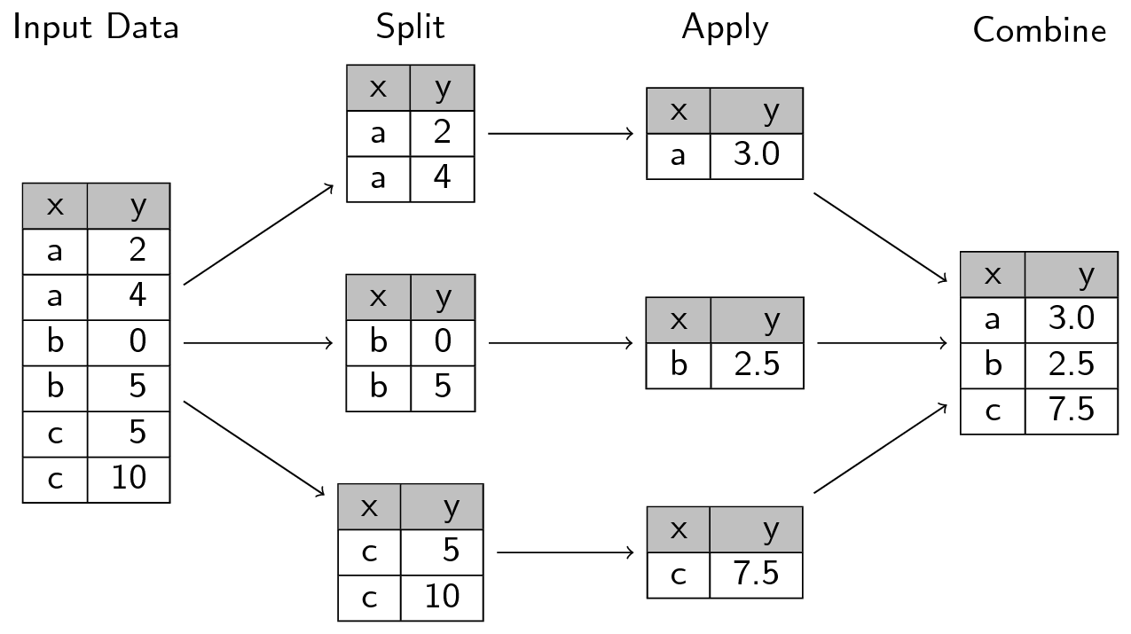
Split-apply-combine

Slide 8
dplyr : only for data frames
6 functions
select() ~ ‘cut’ - split
filter() ~ ‘head’ / ‘tail’ - split
group_by() - split
summarize() - apply and combine
mutate() – apply and combine
6. %>% - Piping!

Slide 9
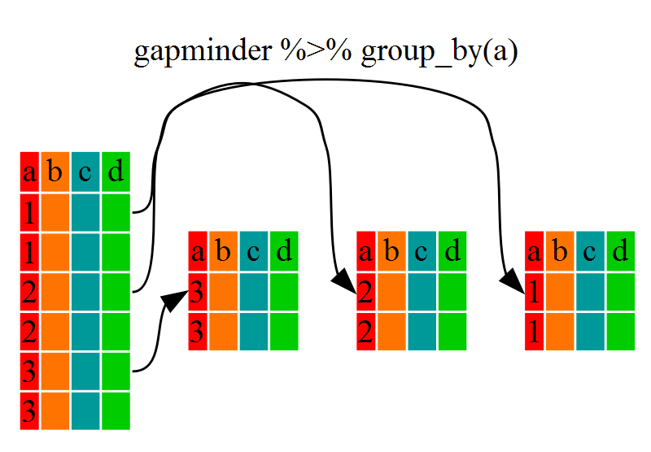
In Gapminder dataset, it can be
1: Asia
2: Europe
3: Africa
4…

Slide 10
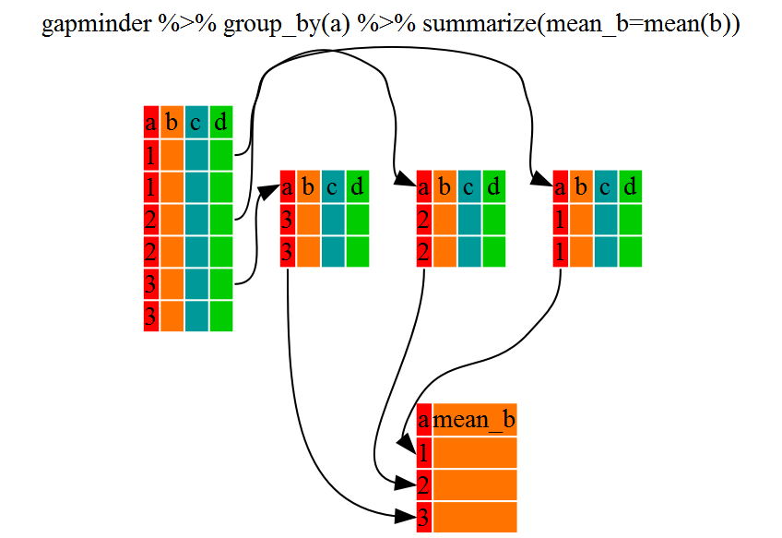
In Gapminder dataset, it can be
1: Asia
2: Europe
3: Africa
4…
→ e.g. You want to find the mean of the GDP for each continent

Slide 11
Controlling flow: Conditions
Sometimes we want to make sure an action is executed, only when some conditions are satisfied --if statements --if..else statements
if (condition is true) { perform action
} else { # that is, if the condition is false,
perform alternative action
}

Slide 12
Controlling flow: repeating operations
Sometimes we want to repeat the same actions on a series of objects/variables --for loop --while loop (combine with a condition)

Slide 13
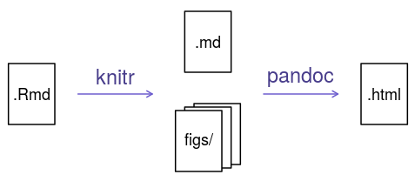
Knitr and Rmarkdown conversion

Slide 14
Some useful URLs
Cheatsheets
https://www.rstudio.com/resources/cheatsheets/
Software Carpentry Gapminder R lessons
https://swcarpentry.github.io/r-novice-gapminder/
Stack OverFlow
https://stackoverflow.com/
These slides
http://bit.ly/slides-07-2017-swc-ucsf-r

